Slide 1

TEMPORARY STRUCTURES IN SITE PLANNING
REVIT University
FROM PRELIMINARY DESIGN TO SCHEMATIC DESIGN
Revit UNIVERSITY – July 19, 2023
PRESENTED BY Andres Fernandez, Christian Quintero

Slide 2
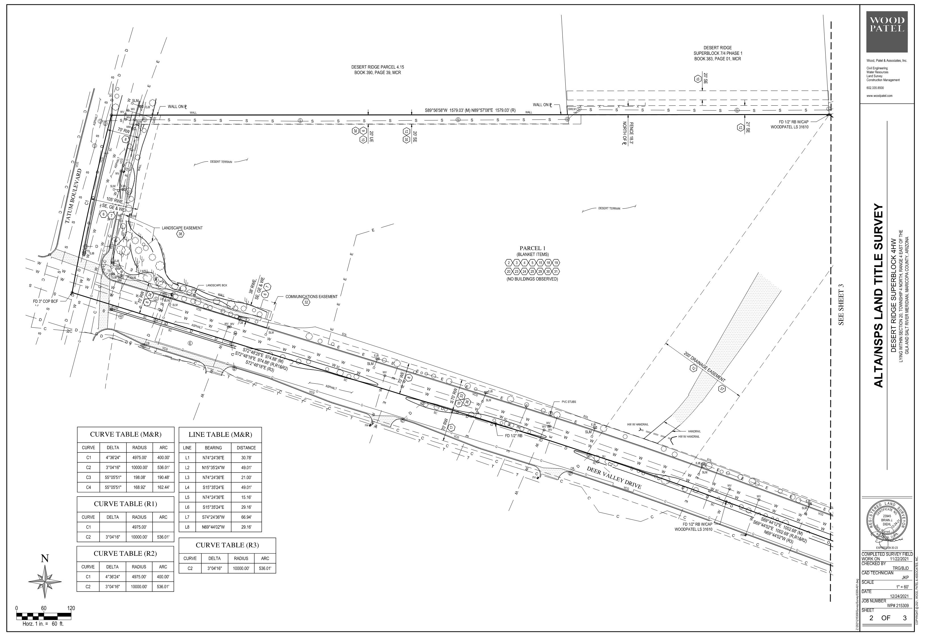
PRELIMINARY SITE DESIGN
ORB uses the Temporary Structures category in Revit to create small, light, and efficient families that represent units, stair and elevator shafts, storage, commons spaces, etc. These provide a quick and efficient way to lay out the architectural program requirements without having to constantly re-draw geometry heavy Revit elements or having to constantly count units over and over after each new iteration

Slide 3
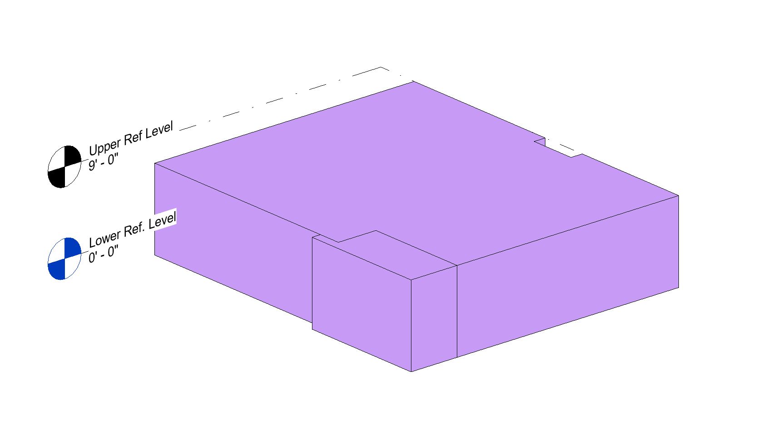
TEMPORARY STRUCTURES CATEGORY
All Temporary Structures are based on a Generic Model Family that is Two Level Based. This allows us to set lower and upper limits to all of these families, thus being able to extract unit information per level. Another advantage is that if we need to modify a level height, all families will automatically follow suit.
ORB Temporary Structures will be divided into different categories themselves:
Units
Vertical Circulation
Commons Elements

Slide 4
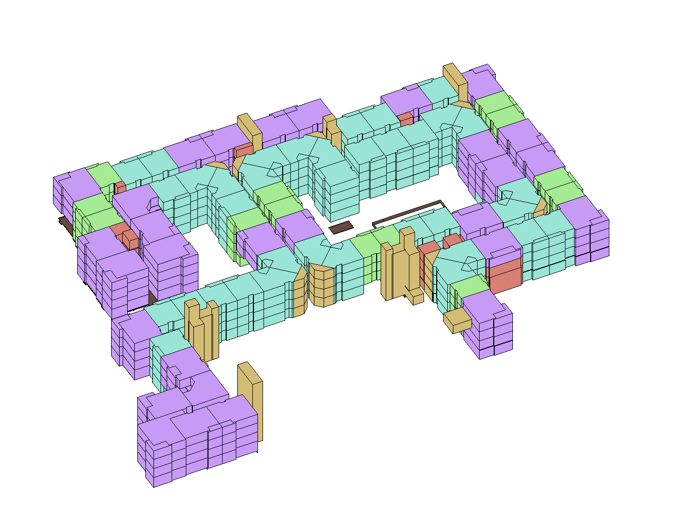
TEMPORARY STRUCTURES CATEGORY
Units
Vertical Circulation
Commons Elements

Slide 5
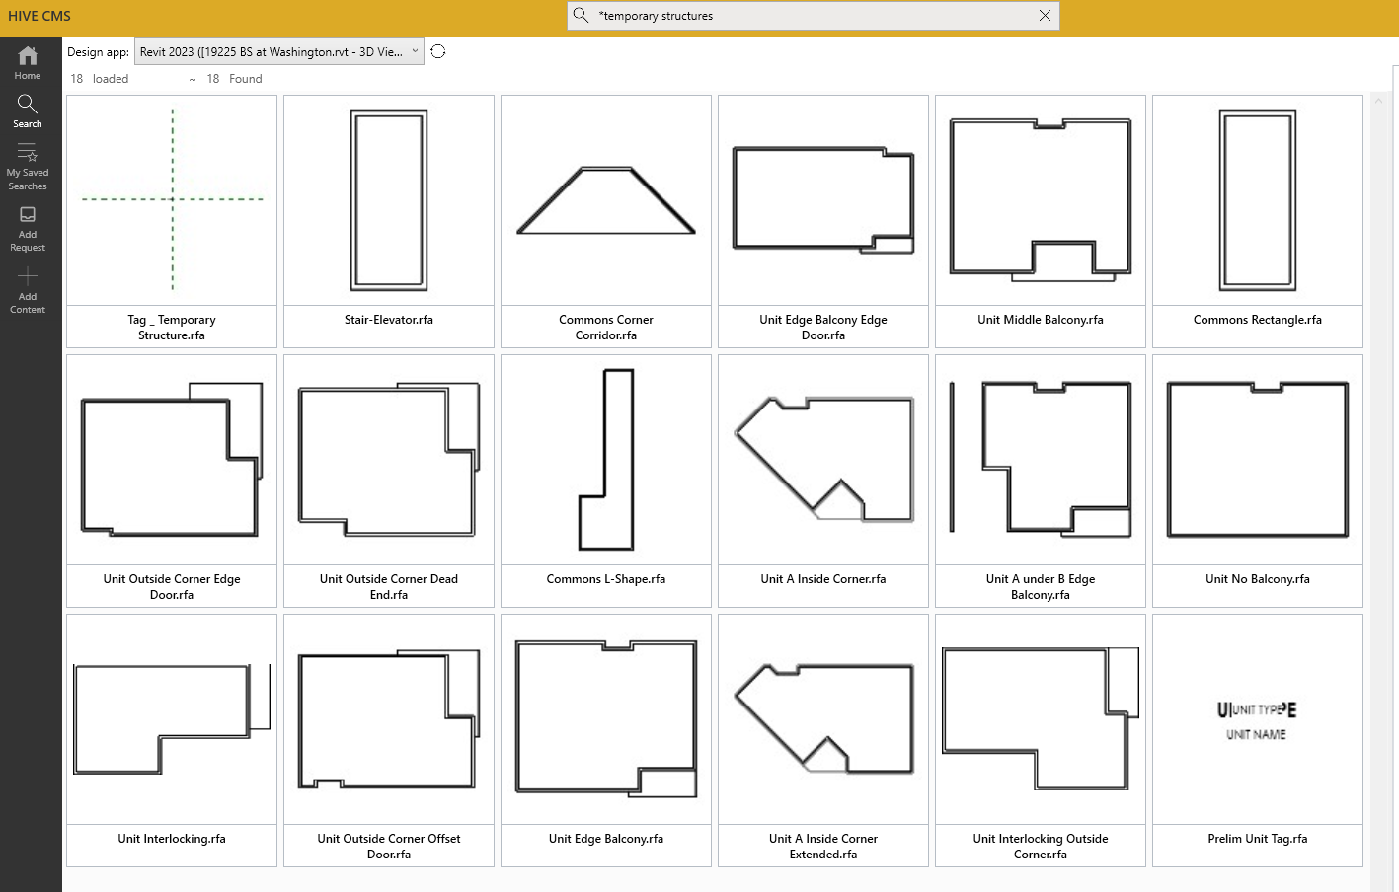
ORB UNITS

Slide 6
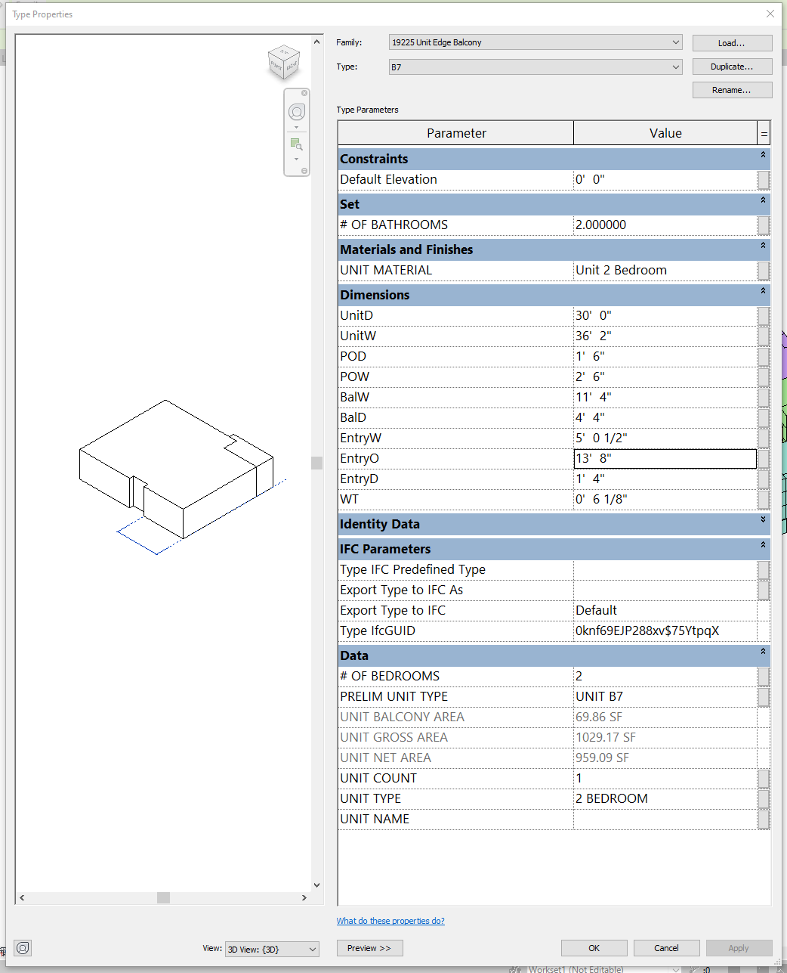
UNIT PARAMETERS
COORDINATE WITH # OF BEDROOMS
USED FOR AREA CALCULATIONS
USED TO SET THE ORDER
CALCULATED AUTOMATICALLY
ALWAYS SET TO 1

Slide 7
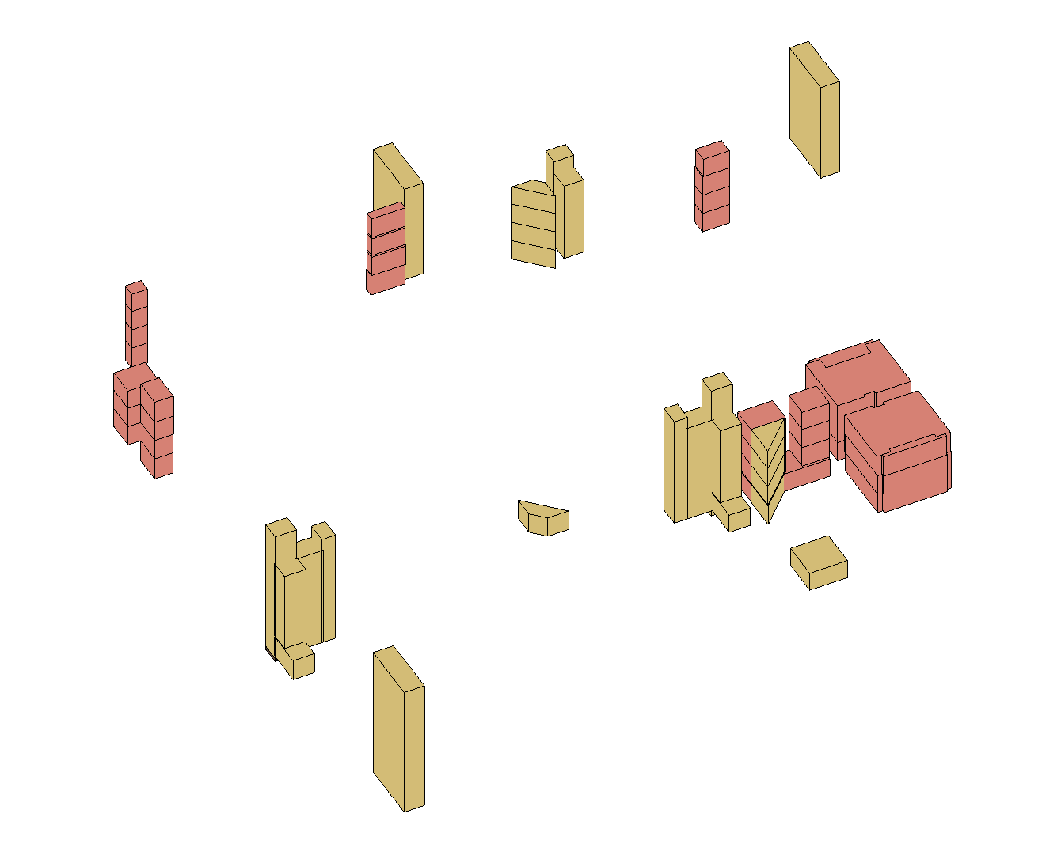
VERTICAL CIRCULATION AND COMMONS
Leasing
Offices
Rec
Fitness
Storage
Electrical Rooms (Meters, IDF, enclosed SES, etc)
Bike Storage
Retail spaces
Project specific elements

Slide 8
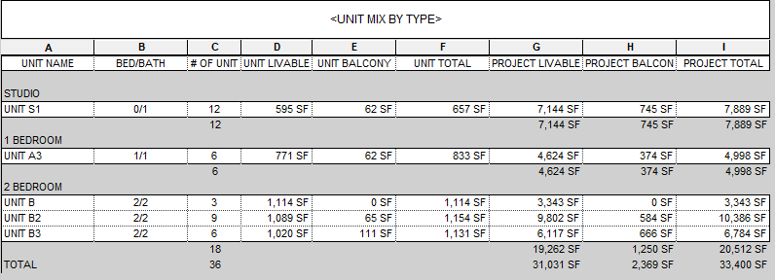
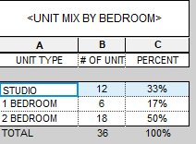
PRELIMINARY DATA
Verify the submittal requirements for each municipality and determine if these schedules will need to be revised or duplicated to provide the information in a format that is acceptable or requested by the authority having jurisdiction

Slide 9
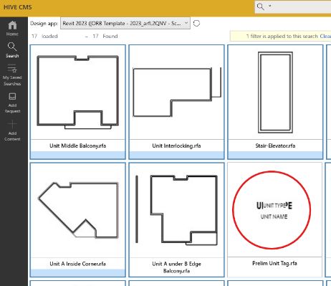
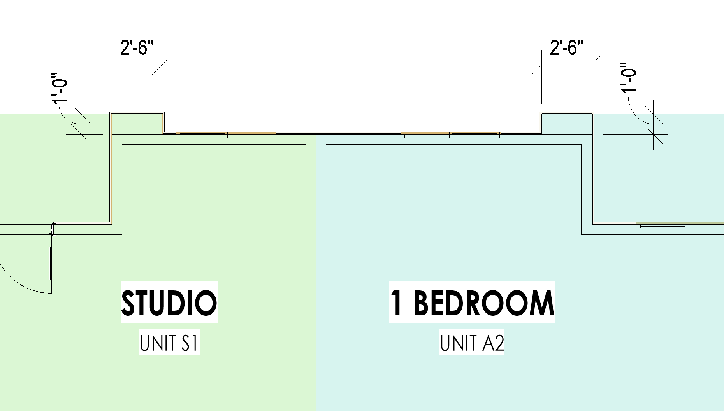
TEMPORARY STRUCTURES TAG

Slide 10
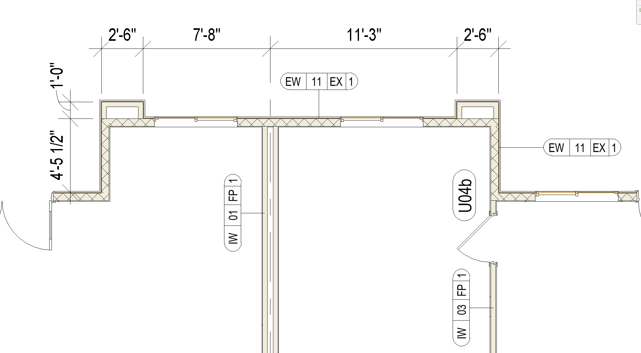
FROM SDs THROUGH CDs
Lock Unit Families in place and workset
Edges of families will provide guide line for exterior walls and alignment for RVT unit links.
Building Unit Families workset becomes invisible in all views
Confirm final unit mix between Temporary Structures and RVT links in the model – the numbers must remain the same throughout.

Slide 11
BEST PRACTICES
Verify Site requirements and limitations
Use the working view with project north. Site plan annotation views must always be towards true north.
Confirm with PM or client the required areas for leasing, gym, rec, etc.
Create levels for the project – families will be tied to the levels
Create half levels for garage buildings
Think product, not project.
Use side monitor to keep close eye on unit mix schedule
Use Building # parameter to sort different possible layouts
Always verify your data before printing or sending out to clients. The information is only useful if it is true.

